Slide 1

Data Types In Python
Nikhil Darokar

Slide 2
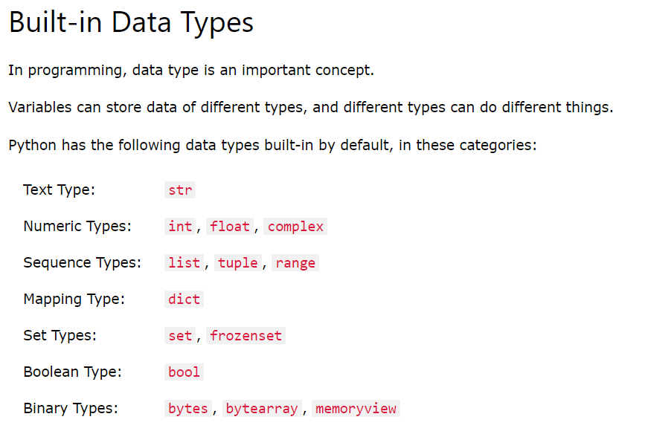
Data Types In Python

Slide 3
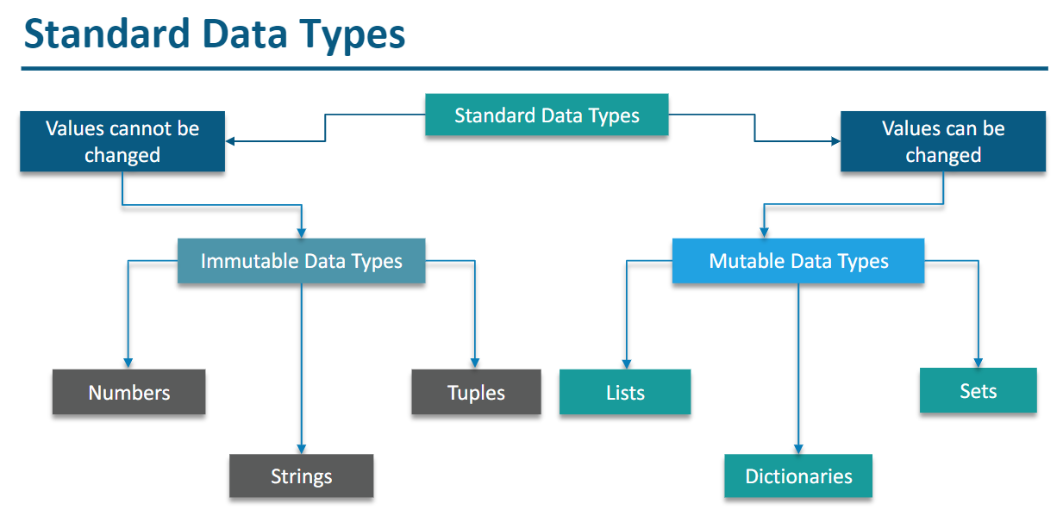

Slide 4
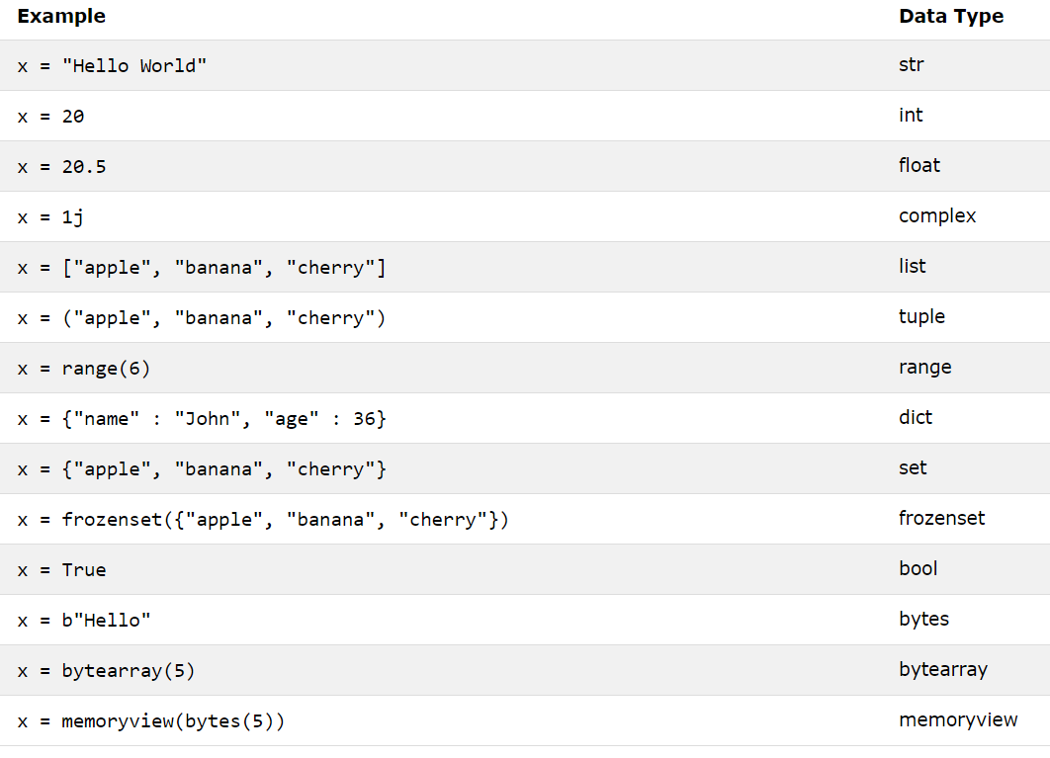

Slide 5
Thank You
Nikhil Darokar

